Slide 1
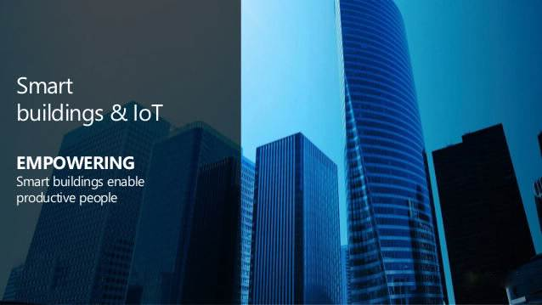

Slide 2
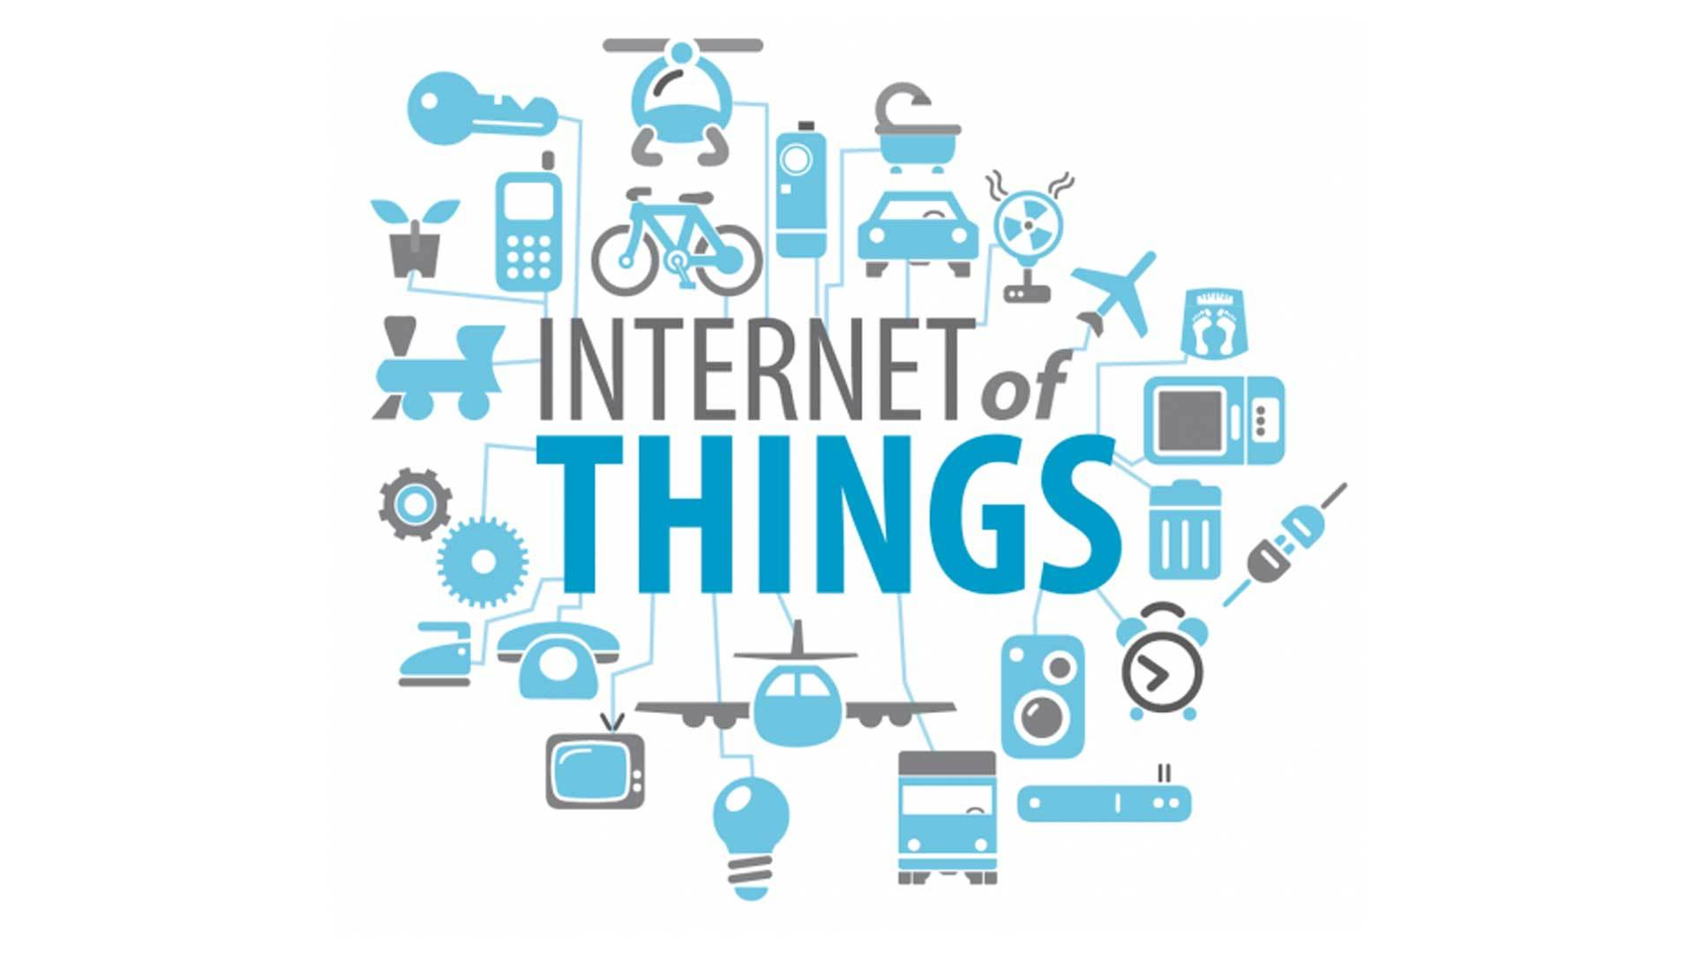

Slide 3
The Internet of Things is the concept of connecting any device to the Internet and other devices. The IoT is a giant network of connected things and people whose data is collected and shared.
Devices with sensors are connected to an IoT platform, which integrates data from the different devices and analyze it to share only valuable information with Web-Apps built to address specific needs.

Slide 4
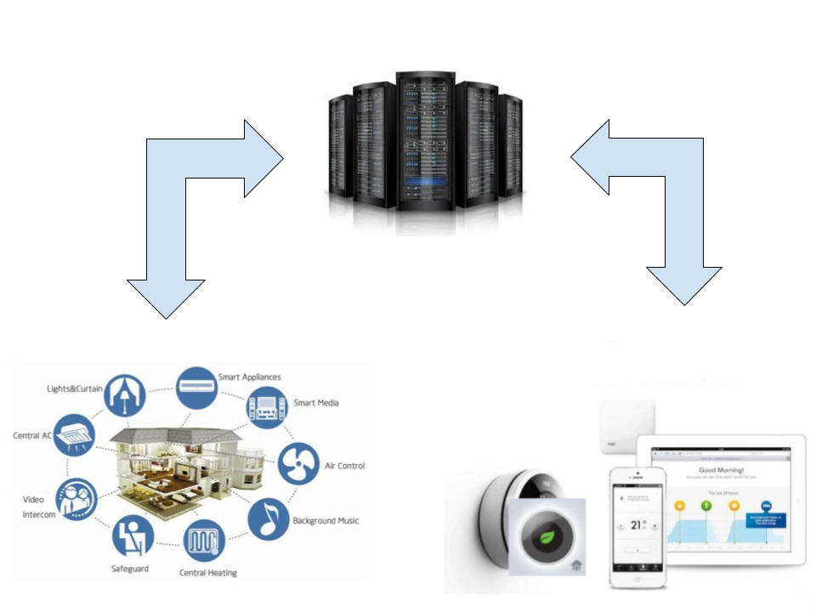
Implementation of a Smart Room
Servers
There is a continuous data transfer between the mentioned 3 components through TCP protocols.
The servers save, process and send processed data to the user in a visual format that is understandable.
IoT Devices
User Interface

Slide 5
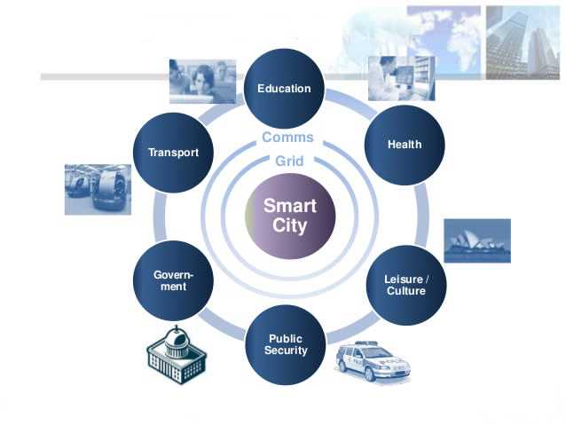
Future OF IoT in a City
Many Smart Buildings in a city will develop to be a smart City where IoT can be applied in the mentioned various fields.

Slide 6
Thank You

